Slide 1
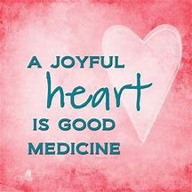
Resiliency
Finding a Joyful Heart
Notes:
Hi
Today I’m going to talk for a bit on Resiliency – why it matters, common traits of resilient people, and how to build it in ourselves. Resiliency is a skill, just like any other, and the more we work on it, the better we get at it.

Slide 2
Why Resiliency Matters
Notes:
Resiliency is the ability to effectively cope with stress or adversity and to be able to bounce back. Problems may include severe stress related to the loss of a job, financial problems, emergencies, nature disasters, or the illness or death of someone close to you. Or just the day to day stressors – traffic, deadlines at work, taking care of your family that can build up and feel overwhelming.
Resilience does not eliminate stress or erase life's difficulties. It provides you with the tools for healthy coping.

Slide 3
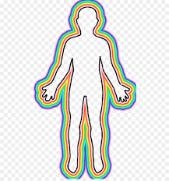
Acute Stress – Your Body’s Response
When you experience acute stress – deadlines, slamming on the breaks to avoid an accident, a physical emergency for yourself or a loved one – a number of things happen in your body.
Musculoskeletal: muscles tense up to guard the body from injury
Respiratory: you breathe harder – pumping oxygen into your system
Cardiovascular: heart rate increases and there are stronger contractions of the heart muscle. Additional blood is pumped to the large muscles and the heart, elevating blood pressure.
Endocrine: the body is looking for energy, so the hypothalamus causes the adrenal cortex to produce cortisol and epinephrine. The liver releases glucose into the system to give your muscles something to burn.
Gastrointestinal: you may eat more or less than normal, your stomach may feel queasy, and your digestive system may feel out of whack.
Nervous System: flight or fight reaction is triggered and all of the body’s resources are shifted toward resolving that real or perceived danger.
Notes:
It’s important to understand that our body is very good at responding to acute stress. Those short term things that can happen – slamming on the breaks or responding to an emergency.
When faced with acute stress there is a whole body response.
Our muscles tense to protect the body and to be able to spring into action. You literally become tense.
Our breathing becomes heavier in order to pump more oxygen to our muscles and brain.
Our heart beats faster, pumping more blood to the parts of the body that need to respond.
Hormones pump through our body – cortisol and epinephrine (EN IN EF RIN). Glucose is released, giving muscles something to burn.
You might feel queasy or like your digestive system is out of whack.
Fight or flight is triggered and all of the body’s resources are being channeled to the areas necessary to respond to danger.

Slide 4
Lions and Tigers and
Bears, oh my!
Our systems evolved to ensure that we did not become someone’s lunch.
Notes:
This was critically important in a time when your life depended on a flight or fight response. You didn’t want to become someone’s lunch.

Slide 5
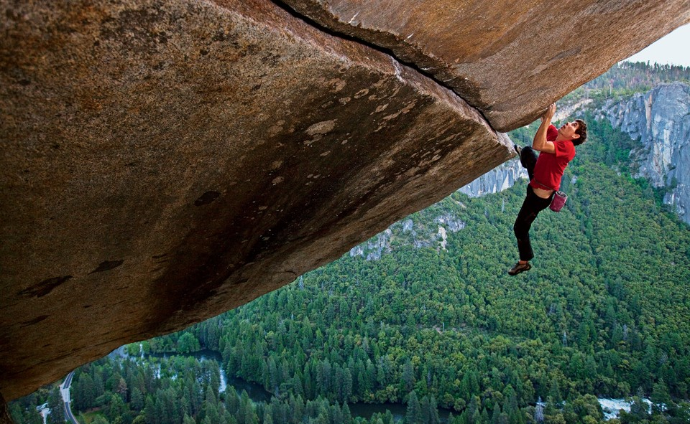
Short term stress isn’t a problem.
With short term stress, the body’s systems return to normal.
Notes:
Short term stress can be enjoyable. People experience stress recreationally – they might ride a roller coaster, sky dive, or rock climb the side of El Capitan in Yosemite. It can create a sense of excitement – a rush.
In the short term, you body’s systems reset and things return to normal.

Slide 6
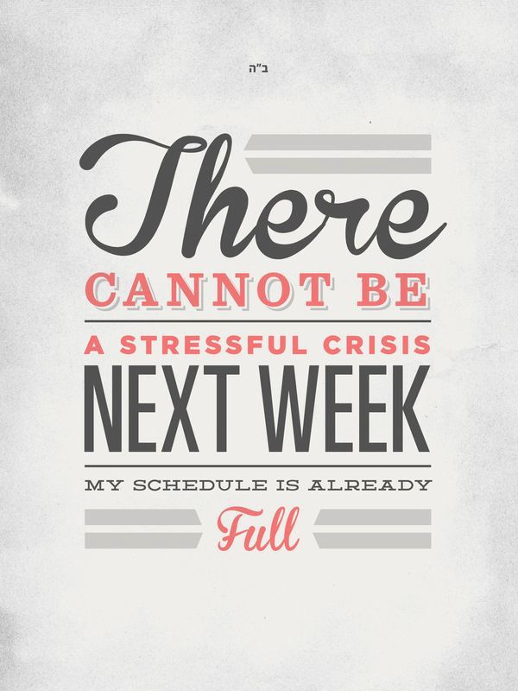
When Acute Stress becomes Chronic Stress
Riding a roller coaster may be fun, but if the ride never ends, your body and mind will continue to respond until your systems become exhausted.
Notes:
The problem is when that acute stress becomes chronic. Your body will keep responding at some level to the perceived threat. Eventually, your systems become exhausted, which means it is hard to keep functioning at a normal level. You start to feel overwhelmed and it is harder for you to continue at that level.
Your body can become hypervigilant thinking it will need to respond to a threat and stores the unused hormones where they will be needed. That’s why too much cortisone can result in belly fat. Your body can become overtaxed trying to handle the overload.
You might sleep too little or too much.
Your might feel muscle pain or headaches.
It might be difficult to concentrate.

Slide 7
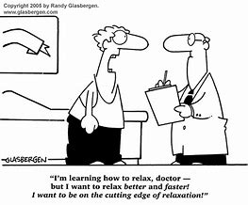
Stress happens – building resiliency helps you manage it
Notes:
Building resiliency is an important part of our overall health. It is not a situation where some people are born resilient and others not – it is a skill that you can, and should cultivate and practice. There will always be stress – how we chose to cope with it, and our ability to do that, is the key

Slide 8
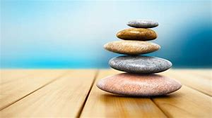
Five Steps of Resiliency
Self Knowledge and Insight
Sense of Hope
Healthy Coping
Strong Relationships
Personal Perspective and Meaning
(taken from OVC’s Building Resiliency in Child Abuse Organizations)
Notes:
The DOJ Office of Victims of Crime recognized that resiliency was an important skill for staff working in child abuse response organizations and developed a curriculum that is available on their website. As you know, people working in this field are exposed to a lot of secondary trauma. It can have a significant impact on their lives if they are not actively practicing skills that help them cope in a healthy way.
OVC tested the curriculum in a number of organizations, including several Children’s Advocacy Centers.
They found that there are five steps to becoming and staying resilient:
Self knowledge and insight
A Sense of Hope
Healthy Coping
Strong Relationships
Personal Perspective and Meaning

Slide 9
Self-Knowledge and Insight
Notes:
Self Knowledge and insight –
This includes being able to embrace change, developing a sense of control, building problem solving skills, setting goals, taking action to solve problems, and nurturing a sense of self-compassion.
Compassion, for yourself as well as others, has been found to increase happiness and well-being and reduce stress.
Change can be hard when you are already feeling stressed. Just remember that they engineer those big bridges to expand and contract so they can remain strong.
I went to Evergreen State College here in Olympia and it uses an interdisciplinary approach rather than separate classes. You work around a theme and study different disciplines as part of that. One semester the theme was holding on and letting go. At 18, that didn’t really resonate with me. By the time I was 30 I realized that everything in life is about holding on and letting go.

Slide 10
Sense of Hope
Notes:
A sense of hope is the belief that, no matter what happens, things will work out. The future offers promise.
Three components to this include having a sense of humor, the ability to have fun, and optimism.
Humor helps us reframe problems – and look at them from a different perspective. We often tell stories about something that is funny now but seemed terrible at the time. Tragedy + time = comedy
Having fun lifts the spirit and gives us a chance to breathe. Adults sometimes forget to play – it is important to try to build that in.
Optimism is the idea that good things will happen – yet at the same time being realistic. Asking, what is something good that can come out of this experience?

Slide 11
Half full or Half empty?
Notes:
When we talk about optimism, people often use the half-full, half-empty metaphor. Do you see the glass as half-full or half-empty? The idea being that optimists see it as half full and pessimists see it as half empty.

Slide 12
A different perspective
Notes:
The trick is to remember that the glass is refillable. Building resiliency skills is a way to keep the glass full. You can’t pour from an empty cup (or glass for that matter). To be present in the way that you want to be, you have to keep filling that glass.

Slide 13
And a very different perspective
Notes:
The nerds I live with want me too remind you that technically the glass is completely full.

Slide 14
Healthy Coping
Notes:
Another component is Healthy coping, which is the ability to take care of yourself when faced with the stressors in your work and personal life. Components include:
Commitment to the truth – morality and integrity
Knowing right from wrong, a low tolerance for bad behavior, and the courage to act when you see something wrong.
It’s also about being honest with yourself if you are struggling or feeling down – it is okay to ask for help
Another is Empathy – the ability to see things from another person’s perspective.
And also Intentional practice – living with intention. Collaborating, participating, taking risks, and being creative all build resiliency.
There are a lot of things you can do to help cope. Exercise helps work out those stress hormones so they don’t stay hanging out in your body, getting stored as fat. (when you don’t use the chemicals and glucose, your body stores it for next time). Breathe. Listen to music, get outside and enjoy nature, dance, create, watch a touching or funny movie.
I recently read that dancing is a great way to work out some of the body’s reaction to stress. So next time the music in the grocery store moves you, do a little happy dance in the produce aisle. You will make someone smile or even laugh. To see a great example of this, watch some of Improv Anywhere videos on you tube.

Slide 15
Strong Relationships
Notes:
Strong relationships are also important – that is being able to connect with others and build mutual care and support. These are people you can talk to, who will listen, share feelings, give positive feedback and help with strategies and solutions.
It is about recognizing when you need support and asking for it – and recognizing when others need support and giving it. Helping others not only builds their resiliency, but yours as well.

Slide 16
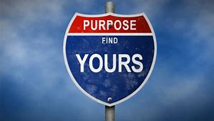
Personal Perspective and Meaning
Notes:
And finally, personal perspective and meaning.
The three components are
Morality and Integrity
Spirituality
Coherent Life Meaning
Morality and integrity are about having a moral compass that helps guide your life.
Spirituality is a sense of being connected to something greater than yourself.
Coherent life meaning is about finding your personal understanding of “why”. What your purpose is and how you make sense of the world in general.

Slide 17
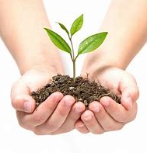
Practices to Building Resilience
Gratitude
Mindfulness
Forgiveness
Connection
Spirituality
Notes:
As I mentioned, building Resiliency is a skill and like any other skill, it requires ongoing practice. The people who study resiliency suggest that integrating these practices into your life helps build resiliency and you will see that they are related to those components of resiliency.
The big 5 are gratitude, mindfulness, forgiveness, connection, and spiritualty
The great thing is that it doesn’t really cost anything to work on these skills and you are probably already doing some of these practices.

Slide 18
Gratitude
Keep a gratitude journal
Find three things to be thankful each day
Notes:
Sometimes the world seems overwhelming and it is difficult to feel positive. Keeping a gratitude journal, or even just taking the time each day to think of something you are thankful for, helps with this. Being able to read back through the past week, month or year and see all of the things you are grateful for helps give you a sense that there is hope. So, think about the person ahead of you at Starbucks who paid it forward, the person who made you laugh, the person playing music outside of the bookstore or metro, or the person who asked if you would like to go ahead of them at the grocery store – they don’t have to be big things – sometimes it is those little moments of grace that mean a lot but slip by without remembering them. A friend of mine has a jar and during the year members of her family write down things they are thankful for and then read them at Thanksgiving.
Even if it is a lousy day and all you can feel thankful for is that you have a bed to sleep in and a roof over your head – that is a lot.
Yesterday, in the heat and smoke, there was a guy playing guitar outside of Trader Joes. He was doing it really well and it made me smile. I only had some change in my car, no bills, and so I scooped up a few dollars with and put them in his guitar case. He thanked me and said they would keep the paper money from flying away. A great example of reframing.

Slide 19
Mindfulness
Take time, throughout the day, to check in with yourself – be present
Notes:
Mindfulness is not some whoo-whoo thing – I got the information for this part of the presentation from the Harvard Business Review. Research is finding that exercising mindfulness enhances cognitive flexibility and facilitates better job performance. It is about learning to be fully present and calm. Police departments and hospitals are starting to integrate mindfulness practices, like meditation, to reduce errors and improve performance. The Seattle Seahawks do it. Between every action and reaction there is space to pause. Mindfulness meditation helps people find that space.
One way to approach mindfulness is through meditation. Even five minutes a day can make a difference. There are several apps listed at the end of the presentation that have short mindful meditations. It is really about slowing down and taking a minute to be aware - of your surroundings, of how you feel physically and emotionally, to take a few seconds to breath in deeply and exhale so you feel present and grounded. Meditation doesn’t have to be sitting for an hour in a lotus position – it can be walking and paying attention to your footsteps – it can be sitting in your chair and listening to your breathe for a few minutes. Or listening to a short guided meditation.
It’s just about learning to be present.

Slide 20
Forgiveness
It starts with yourself
Notes:
There is an old saying that failing to forgive is like taking poison and expecting the other person to die. Failing to forgive is toxic – literally. Resentment can cause your blood pressure to spike and trigger stress hormones. The hardest person to forgive, often is ourselves. Forgiveness involves self-compassion as well as compassion for others. Let me be clear – forgiving someone is not the same as forgetting what they did and setting yourself up for the same behavior. It is about letting go of the pain or discomfort that came about because of the experience. It’s not about letting someone off the hook – it is about taking the hook out of you.
Forgiveness is a verb – it is helpful to take some positive action related to letting go
A word about letting go of pain and resentment. Sometimes we try to numb ourselves so we don’t feel a particular pain or disappointment. Some people do that with food, shopping, drinking, drugs, zoning out with video games, etc. Brene Brown, a person who does research in this area, points out that there is no selective numbing. When you numb yourself to one emotion, you numb yourself to all emotions – so you don’t feel the pain but you also don’t feel the joy. Learn to sit with your feelings.
Learning to let go and move on is an important skill in becoming resilient.
If you haven’t listened to her Ted Talk I’d encourage you to do that.

Slide 21
Connection
Building a sense of belonging
Notes:
Nurturing strong relationships, as was mentioned earlier, is an important part of life. We live in a somewhat disconnected society where we are not necessarily near to family, may work long hour or have a long commute, of live in an area where it is hard to meet folks. Although it can be difficult, it is important to reach out to others to form healthy relationships. Sometimes that means reaching out to help another person, join a class or activity, be part of a team. Being part of a group helps give us a sense of meaning and purpose and provides a support network when we need help.
In a busy world, sometimes you have to make an extra effort to maintain friendships. Working remotely is challenging that way – I have to make an effort to keep connected with the people I care about – who are also busy. That is especially true for me in that my lunch hour is 9:30 in the morning. I make sure to reach out and put things on my calendar – going for a walk with someone, volunteering at the local soup kitchen, being in a book club (or is it a wine club – hard to tell).

Slide 22
Spirituality
Believing in something bigger than yourself
Notes:
Spirituality is a connection to something larger than ourselves. For some people that comes through practice of their religion. For some, it is a connection to nature or music or art – something that provides a sense of awe and wonder. Spirituality helps you define your values and helps you find solace and comfort in something bigger than yourself. It helps provide a sense of hope and a sense of meaning.
You may have seen Laura Vandernoot Lipsky at Leadership a few years back. She’s from Seattle so I’ve had a chance to work with her briefly. She is the author of Trauma Stewardship, and in it she writes about her experience of trying to find ways to reduce the impact of vicarious trauma she was experiencing. She looked at how people were able to be resilient in the face of adversity –sometimes horrific challenges, and she found that a belief in something greater than themselves was a common theme – there is more to life than this.

Slide 23
A simple exercise:
On a sticky note, write down 1 thing that motivates you to do the work you do
Put it in your workspace where you can see it each day
Notes:
So, we are going to take a moment to build a little resiliency here.
I want you to breathe in slowly to the count of 5
Hold it for a count of 4
Then breathe out slowly for a count of 8
Okay – lets do that (count)
Now think about one thing that lights you up about your job – what gets you out of bed in the morning when you want to keep hitting the snooze button. You can work anywhere and do anything, but you work here – what keeps you going?
Write that down on a sticky note and put it somewhere where you can see. Take a moment each day to look at that. It may change as time goes on – you can always do a new sticky note.

Slide 24
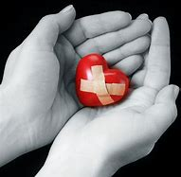
Secondary Trauma – a note
Secondary Trauma impacts the folks we work with in ways we don’t always see.
Kindness and grace are always options.
Notes:
In this field we swim in some very dark water. Many of the people working in this field are exposed to horrific stories and work with children and families who are struggling to cope. We expect people to come to the table healthy and whole but that isn’t always the case. Kindness and Grace are always options, even when someone is being difficult, forgetful, or unresponsive.
That trauma can impact us as well, especially since we don’t deal with the issues directly everyday. So, if you are going to attend a training or sit in on an MDT meeting, or some other thing that may include traumatic information, be sure and go into that situation with intention, do some work ahead of time, and debrief if needed.

Slide 25
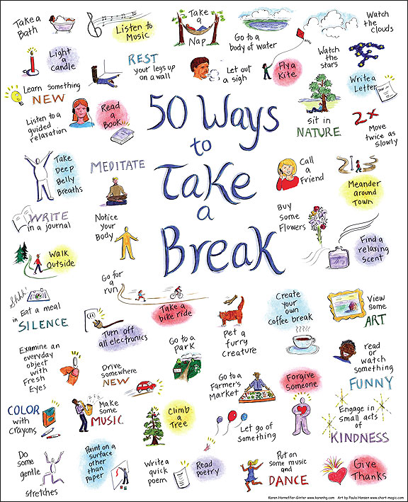
Resources
Websites:
Verywellmind.com
Fullcupthirstyspirit.com (poster)
Dailygood.org
Actionforhappiness.org
Sierra Club’s Daily Ray of Hope
Apps: (some charge for extra features)
Headspace
Calm
Simple Habit
Mental Workout
3 Minute Mindfulness
10% Happier
Wearables:
Spire
Fitbit (heartbeat function)
Notes:
Here is a short list of resources. The poster on the slide is available for free download from Full Cup Thirsty Spirit.com
The Sierra Club Ray of Hope shows up in Messenger each day – you just sign up for it. It is a nice nature picture and a quote.
Some of the apps have a charge for extra features but most have free versions.
Spire is a bio feedback wearable and I listed fitbit on here because mine has a nice 2 minute breathing break that is helpful.

Slide 26
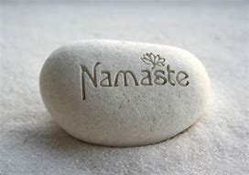
Notes:
Thanks for the opportunity to do this. It was fun to put the presentation together and a good reminder to me to work on my own resilience.

